Slide 1
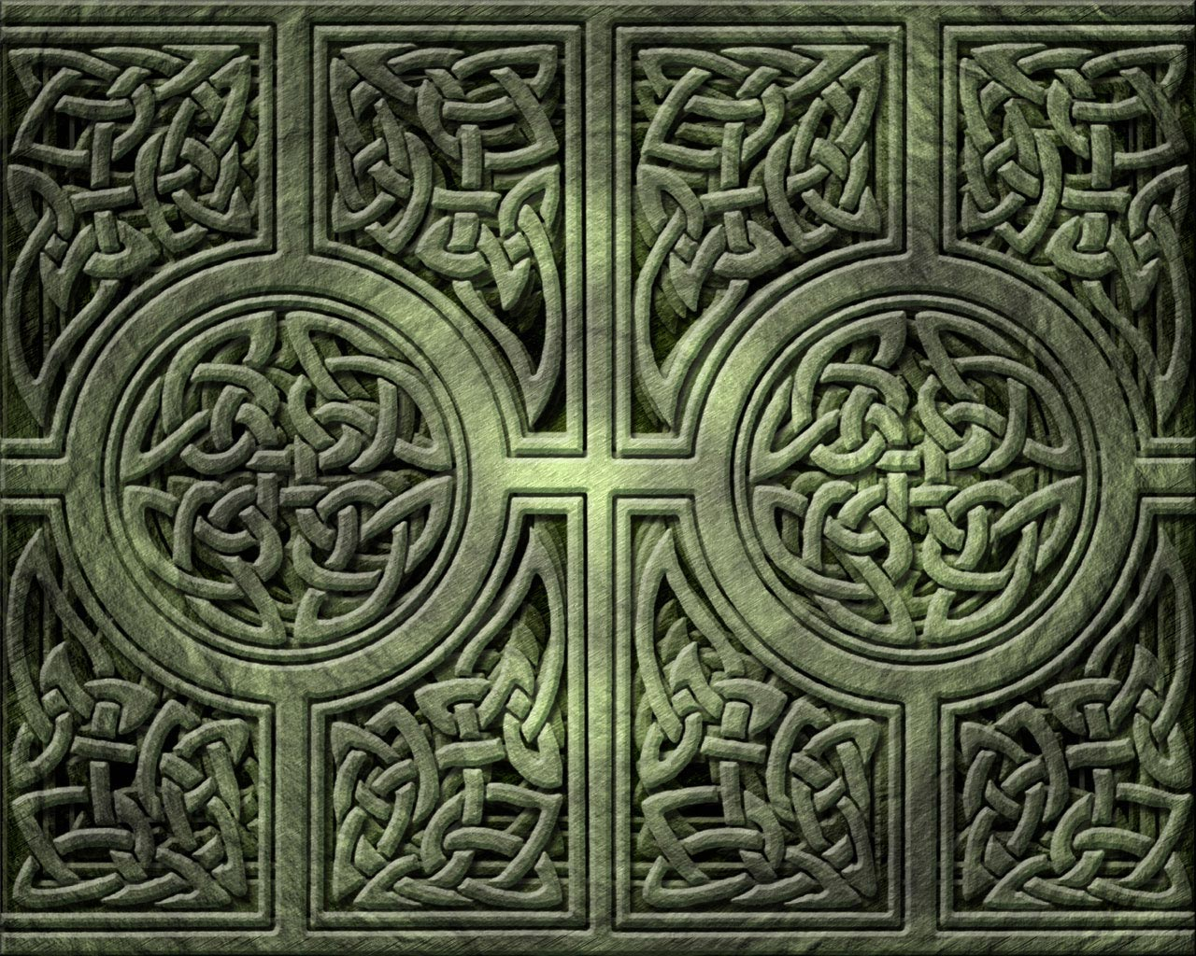
The Celts’ Place in the World

Slide 2
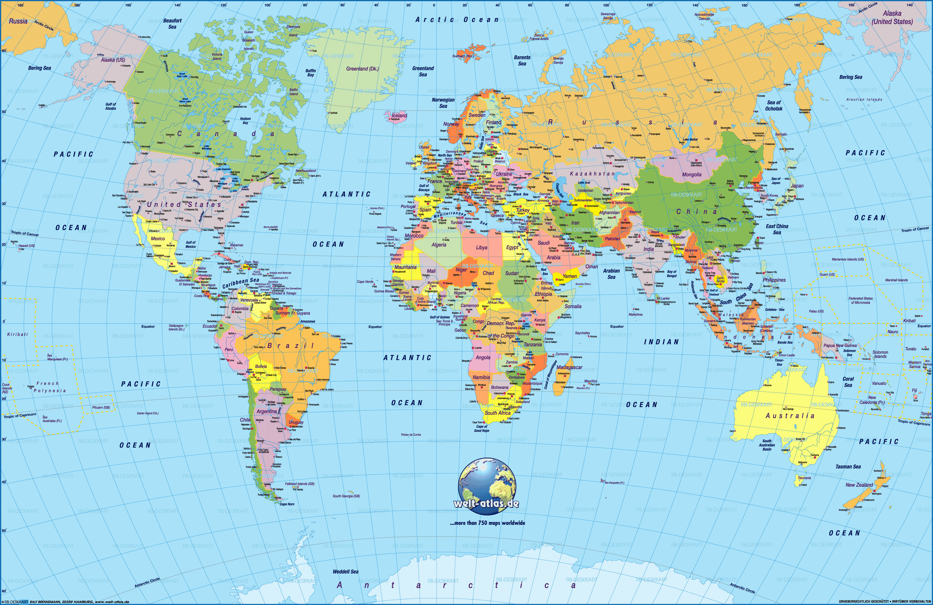

Slide 3
Wales
Thrace
Anatolia
Mediterranean Sea

